Slide 1

Week 6 - Skeleton
Programming 02

Slide 2
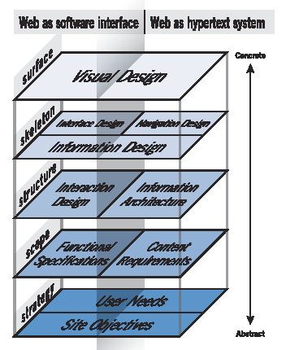
UX Design - Skeleton
Source: Garrett, 2002

Slide 3





Contents
INTERFACE DESIGN
NAVIGATION DESIGN

Slide 4
INTERFACE DESIGN

Slide 5
Interface Design
How the user interacts with the site.
Must be based on the Interaction Design (IxD) of the site.
Successful interfaces are those in which users immediately notice the important stuff. Unimportant stuff, on the other hand, doesn’t get noticed — sometimes because it’s not there at all.
One of the biggest challenges of designing interfaces for complex systems is figuring out which aspects the users don’t need to deal with and reducing their visibility (or leaving them out altogether).

Slide 6
Interface Design Principles
6 major principles of Interface Design (Constantine and Lockwood, 1999)
Structure
Simplicity
Visibility
Feedback
Tolerance
Reuse

Slide 7
Interface Design Principles
The structure principle
Your design should organize the user interface purposefully, in meaningful and useful ways based on clear, consistent models that are apparent and recognizable to users.
Put related things together and separate unrelated things, differentiate dissimilar things and make similar things resemble one another.
The structure principle is concerned with your overall user interface architecture.
The simplicity principle
Your design should make simple, common tasks easy to do - communicating clearly and simply in the user’s own language and providing good shortcuts that are meaningfully related to longer procedures.

Slide 8
Interface Design Principles
The visibility principle.
Your design should keep all needed options and materials for a given task visible without distracting the user with redundant information. Good designs don’t overwhelm users with too many alternatives or confuse them with unneeded information.
The feedback principle.
Every user action in the interface should give a reaction. This is to make sure that the action has been performed successfully. It brings certainty to the user that the action has been performed.
Even if an action is unsuccessful, the user should be informed about it. Moreover, the interface should provide guidance on what they can do next to fix it.

Slide 9
Interface Design Principles
The tolerance principle.
The interface should be tolerant of the human mistakes. It should provide hints and guidance so that the user can achieve the tasks without any mistakes.
For instance, it is much better saying that the set password does not meet criteria at the end of the process. It saves a lot of rework.
The reuse principle.
It deals with trying to avoid duplicating of information and elements. Reuse the elements wherever possible to optimize the interface.
For example, if you have 10 download buttons in your website, make sure you are reusing the original design and not designing 10 different looking download buttons.
Using the same elements for similar tasks will bring consistency in the interface.

Slide 10
Other Principles of Interface Design
Other lists of interface design principles also exist such as:
10 Usability Heuristics for User Interface Design.
http://www.nngroup.com/articles/ten-usability-heuristics/
Visibility of System Status (Inform users with feedback)
Match Between the System and the Real World (Use familiar concepts – avoid jargon)
User Control and Freedom (Support undo and redo, cancel buttons etc.)
Consistency and Standards (Follow industry patterns)
Error Prevention (Try prevent problems in the first place, prioritise high-cost)
Recognition Rather than Recall (Minimise user reliance of memory – make things visible)
Flexibility and Efficiency of Use (Use shortcuts, provide customisation)
Aesthetic and Minimalist Design (Prioritise important, minimalize unnecessary)
Help Users Recognise, Diagnose, and Recover from Errors (Error messages)
Help and Documentation (Provide documentation when needed)

Slide 11
Other Principles of Interface Design
Principles of User Interface Design.
http://bokardo.com/principles-of-user-interface-design/
Clarity
Interfaces exist to enable interaction
Conserve attention at all costs
Keep users in control
Direct manipulation is best
One primary action per screen
Keep secondary actions secondary
Provide a natural next step
Appearance follows behaviour
Consistency matters
Strong Visual hierarchies work best
Smart organisation reduces cognitive load
Highlight, don’t determine, with colour
Progressive disclosure
Help people inline
A crucial moment: the zero state
Great design is invisible
Build on other design disciplines
Interfaces exist to be used

Slide 12
Interface Design - Techniques
Use well-known patterns – don’t reinvent the wheel.
Use consistency – users shouldn’t notice an interface, they just need to use it.
Provide feedback – always inform your users of actions, changes in state and errors, or exceptions that occur. e.g. Highlight important changes,
Keep it simple – break complex tasks into simple steps. But allow power users to miss some of these e.g. keyboard shortcuts.
Keep the user moving forward.

Slide 13
Outputs of Interface Design
The outputs of Interface design are the design decisions on the Interface elements. Interface elements include but are not limited to:
Input Controls: buttons, text fields, checkboxes, radio buttons, dropdown lists, list boxes, toggles, & date fields.
Navigational Components: breadcrumb, slider, search field, pagination, tags, & icons.
Informational Components: tooltips, icons, progress bar, notifications, message boxes, & modal windows.
Containers

Slide 14
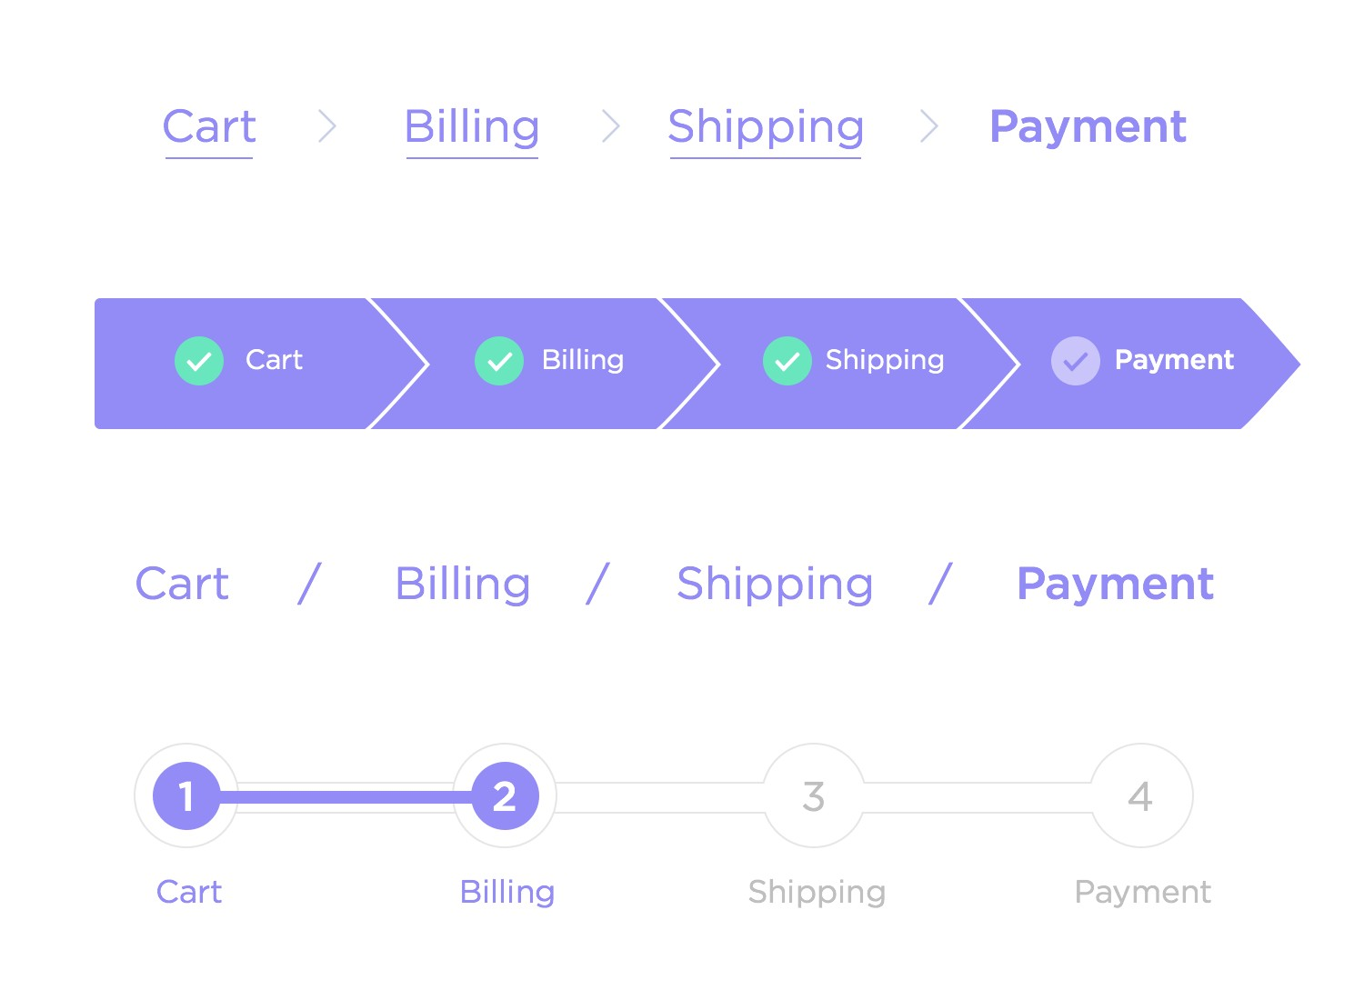
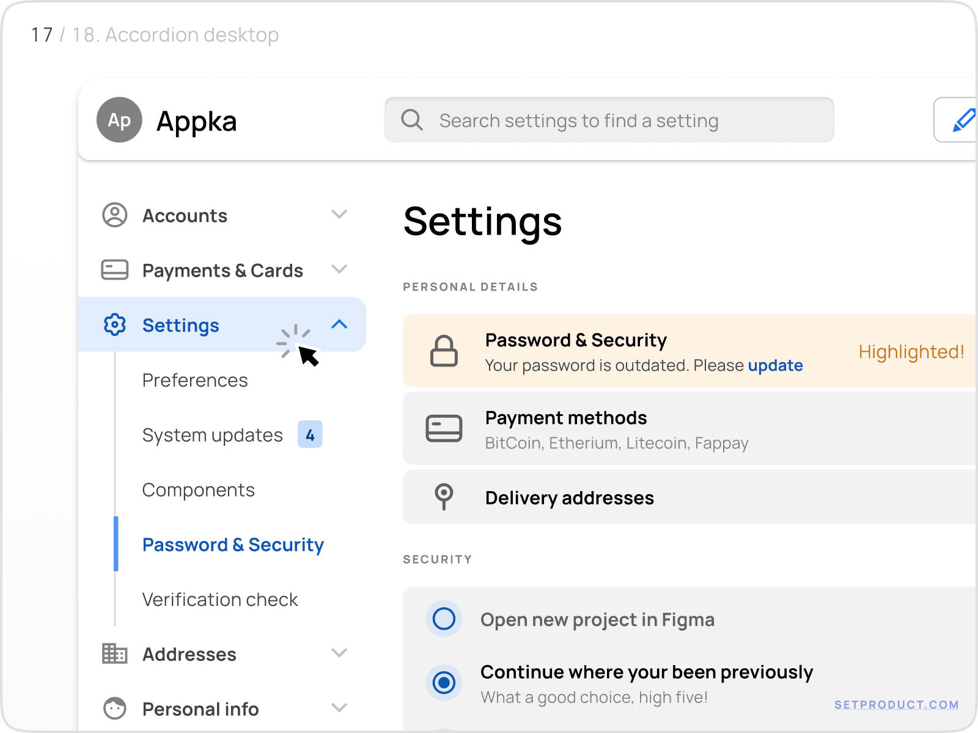
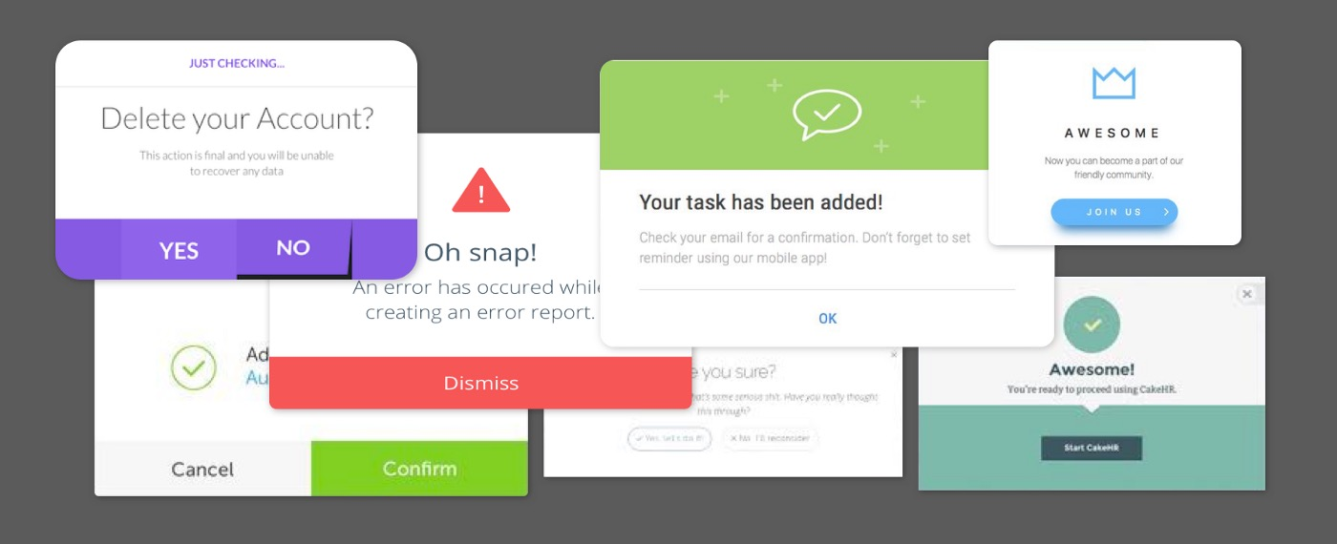
Class Exercise (5 – 10 Minutes)
Find out what the following are and what they are best used for:
Breadcrumb
Accordion
Modal Window

Slide 15
Testing Interface Design
Usability Testing Options at this stage of development can include, but are not limited to:
Guerilla Testing
A/B Testing
Lab Usability Tests
Contextual Enquiry

Slide 16
Testing Interface Design
Guerilla Testing:
Instead of recruiting a specific targeted audience to take part in sessions, participants are approached in public places and asked to take part in research for around 10 minutes.
Provides a quick and inexpensive turn around.
Identifies any UX barriers easy in the process, which allows for agile design.
However, you may not get the right target audience.
Short & casual sessions also may also lose insight and crucial feedback.
A/B Testing:
A/B testing compares two versions of a product, web page, app or concept against each other to determine which performs better.
A/B testing provides quick, definitive results which can help persuade stakeholders.
It is also flexible and can come with other insights.
Though can often yield false positives as a participant can’t suggest C/D/E when in reality they may want E or F. As such you are limited to ideas only you can think of.

Slide 17
Testing Interface Design
Lab Usability Tests:
Participants are invited to a lab where they can be closely monitored by the researcher. Often, they have specialist equipment and can be recorded for in-depth analysis later down the line.
Allows for in-depth qualitative and quantitative analysis, that you have control over.
You can closely monitor and observe user data.
Often can be more expensive, difficult to conduct and time consuming.
Contextual Enquiry:
A contextual enquiry looks into users in their natural environment to determine what they want and need, spending time with and observing the user, while asking questions.
You gain accurate and detailed information about the user’s needs.
Can be very time consuming and requires careful interpretation to make sure the information they gather is statistically significant.

Slide 18
NAVIGATION DESIGN

Slide 19


Navigation Design
DESIGN OF METHODS OF FINDING ONE’S WAY AROUND THE INFORMATION STRUCTURE.
IF CONTENT IS THE HEART OF EVERY WEBSITE, THEN NAVIGATION IS ITS BRAIN.

Slide 20
Navigation Design
The fundamental principle of navigation design is that you should design for the reader — the person who uses the web site. The best-designed sites are reader-designed, with fast download times and multiple paths.
You can’t hold a Web site in your hands. You can’t get an immediate sense of its size or complexity. You navigate through a web site one screen at a time, which can prove to be very disorienting. It’s easy to get confused, to get lost. Creating a navigation system that makes the reader feel comfortable and allows them to find the content they want quickly is no easy task.
(McGovern – clickz.com 2001)

Slide 21
Principles of Navigation Design
Navigation design should seek to:
Help readers quickly find the desired content.
Provide multiple navigation paths for different readers.
Let readers know where they are at all times.
Provide context.
Be consistent.
Provide feedback and support.
Not surprise or mislead the reader.

Slide 22
Principles of Navigation Design
Key Questions:
Where am I?
Where have I been?
Where can I go?
Why should I go there?

Slide 23
Navigation Design Fundamentals
Navigation should be very easy to find.
Place the navigation “above the fold” i.e. high up on the page.
Below the banners – avoid “banner blindness” - don't place any navigation elements above your banner ads.
Use obvious section names.
Remind the user where they are – don’t make them guess. Use prominent page titles and change the link that relates to the page the reader is on to be different. Let them know where they have been and let them know where they can go. i.e. show hyperlinks in different colors or provide breadcrumbs.

Slide 24
Navigation Design Fundamentals
Less is more – “Quality, not Quantity” - build your navigation so that it 'streams' users into progressively more and more specific information.
Keep it consistent - on each and every page of your site, whether it's your forums, your links page, or anywhere else, locate your navigation in the same place, with the same styles

Slide 25
Navigation Design Fundamentals
Don't be adventurous with navigation – use the same conventions as everyone else. E.g. logo in top left-hand side of the page, search box in the same place on each page etc.
Add a 'Home' button - Your home page is the most important page on your site, so make sure your users always know how to get back to it.
Provide a variety of navigation options.

Slide 26
Navigation Design Fundamentals
Leave out the unimportant stuff - links such as 'Contact Us' and 'Privacy Policy' are best left out of your Website's main navigation. The most common place for these to go is at the bottom of the page.
Provide support and feedback, e.g., sitemaps, contacts on each page, etc.
Keep it fast - optimize your images, your HTML and your stylesheets to ensure everything loads as fast as possible.

Slide 27
Navigation Design Patterns
There are various types of navigation including, but not limited to:
Horizontal
Vertical
Mega Drop Down
Sticky/Fixed
Fat Footers
Responsive
Logo (Images)
Primary/Secondary
Source: 10 Great Examples of Website Navigation Design https://agentestudio.com/blog/website-navigation-design

Slide 28
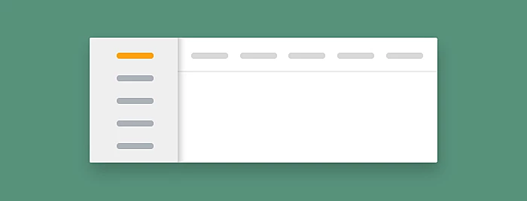
Navigation Design Patterns
Horizontal vs Vertical
Horizontal/Vertical are probably the navigation method you will be most familiar with. Often smaller websites may prefer horizontal, while larger corporate websites will use a combination of both, though there is no fixed standard, but horizontal is often seen as more modern by itself.

Slide 29
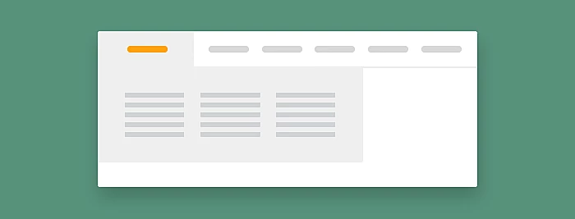
Navigation Design Patterns
Mega Drop-Downs
Mega drop-downs are large menu panels that typically drop down or fly out from a global nav bar. Mega drop-downs work well for e-commerce sites where the category lists are quite large and would not look great in a standard navigation menu. They also work well for sites that have a large list of services.

Slide 30

Navigation Design Patterns
Sticky/Fixed
Sticky or fixed navigation does not disappear when the user scrolls down the website. Usually, sticky type is used on sites where the main call to action elements are situated on the primary bar.

Slide 31
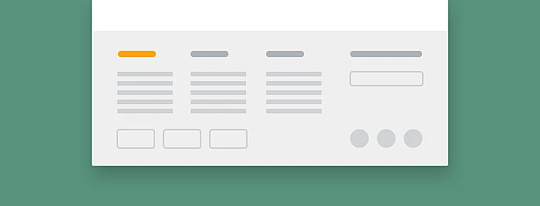
Navigation Design Patterns
Fat Footers
Footers provide information regarding privacy, legal links, email sign up fields, address details and social links, though can also contain navigation elements like a site map. IT tends to be used for sites that are quite content heavy or e-commerce sites where displaying the security icons and methods of payment is quite crucial.

Slide 32
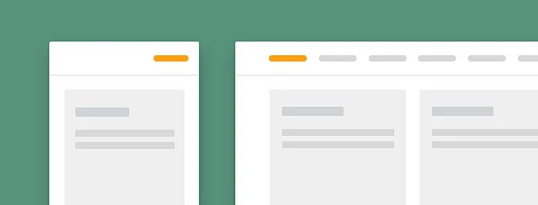
Navigation Design Patterns
Responsive
We have touched upon the importance of responsive web design in prior weeks to make websites look good regardless of the user’s viewing device. Usually, navigation bars will collapse into a ‘hamburger’ menu for mobile as they don’t take up a lot of space.

Slide 33
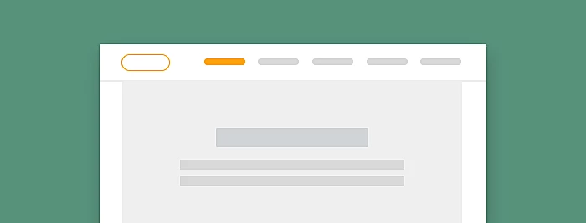
Navigation Design Patterns
Image (Logo)
It sounds obvious, but some websites neglect this rule. This is a convention best followed as it is so widely implemented.

Slide 34

Navigation Design Patterns
Primary / Secondary
The most common primary navigation consists of the main items, which is consistent throughout the site. Typically, in user-focused design examples, the main menu is placed on the top of the page in the centre or aligned to the left or right of the page. Secondary navigation consists of additional items and is typically situated in the middle of a webpage without an expressed design.

Slide 35
Navigation Design Testing
Card Sorting:
Was mentioned previously for testing content but can also be used for navigation. You can use sticky notes for all the pages of your website and ask a user to nest them under your main navigation headings.
Is useful for discovering new areas and labels.
Tree Testing:
You create a prototype of your navigation as a ‘tree’ of hierarchical menu displayed as a list of accordions to test the labels and categories of your navigation system.
Process is to test hierarchy and structure of navigation tree.
Technique is employed to see if the navigation is intuitive and makes sure users can navigate to achieve their goals and objectives.
Examples of tree testing utilities:
Userzoom - https://www.userzoom.com/
Treejack - https://www.optimalworkshop.com/treejack

